Slide 1
SESSION 1 - INTRODUCTION
Python Workshop 1711/1712

Slide 2
Workshop – Proposed structure
Session 1 – Intro
Overall introduction to Python
Showcase of example applications
Exercises
Session 2 – Basic concepts 1
Data structures
Loops and conditionals
Exercises
Session 3 – Basic concepts 2
Functions
Imports
Session 4 – Plotting
Customizing plot layouts
Subplots
Session 5 – Pandas
Manipulating tables with the Pandas package
Plotting heatmaps of data
Session 6 – ???
What do we want to do from here?
Split in groups according to interests?
Let’s discuss
Session 7 – …
…

Slide 3
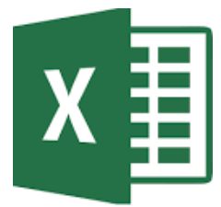
Excel
Excel is the right tool for many things, but it has some issues:
Keeping track of ranges is a very manual process --> prone to errors
Cell formulas, like nested IF-statements, can be very hard to read
It’s hard to reproduce problems or make sheets work for new problems
It’s slow for many rows (>100K)
Plots of data from filtrered table does not work well
Plots are not very dynamic
Advanced plots not available (colormaps, 3D, subplots etc.)
No option for ”equal axes” in plots (circular and sqaure shapes get distorted)
Version control almost non-existent
Some Excel work is already programming!
Python could be a good ”extension” for complex stuff we normally do in Excel

Slide 4

Why Python?
Engineering and data science
Powerful langauage
Easy to learn and concise syntax
Approachable for non-developers
Free to use and constantly improving
Free to use and Open Source
New versions and features often released
Huge community
Arguably most popular programming language right now
Lots of online material and sources to get help from
Built-in features and third party libraries
Many functionalities already built in
Additional functionality from countless third party libraries
Most notable ones: Numpy, Pandas, Matplotlib

Slide 5
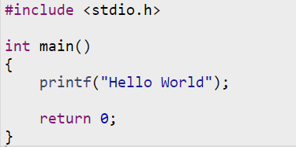

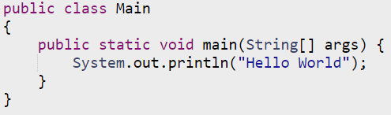

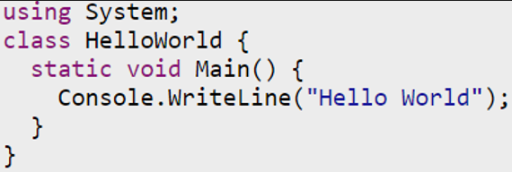
Hello World in six languages
C/C++
Fortran
Java
MATLAB
Python
C# (pronounced C-sharp)
Low level / High level languages
Simple explanation of why Python is so popular.

Slide 6
Where to write and run the code
Text editor
Software to write and run the code
Could in principle be Notepad
Many editors to choose from
Extensions to make life easier
Many supports version control
Show the editor
Jupyter notebooks
A more basic editor in the browser
Ships with the Anaconda installation we use
Supports markdown with math typesetting
Combines code and text
Used for reports, articles and even books
Show a notebook

Slide 7
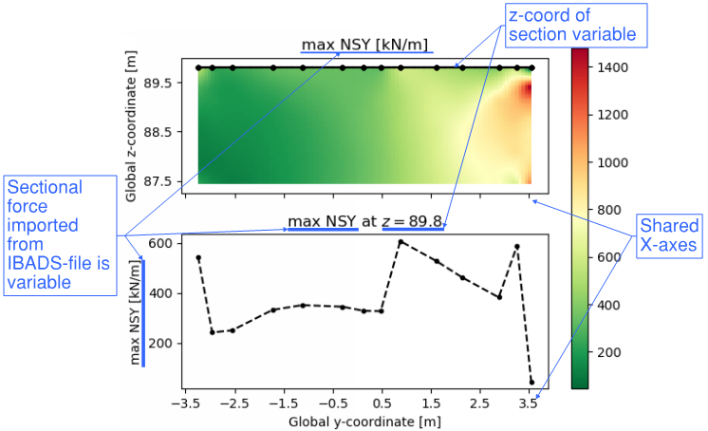
Examples - Plotting
Results from IBDAS text file (.csv with many thousand lines)
Imported data filtrered for load comb + criterion before plotting
Values for cut at height z shown as line plot
Setup takes some time
Afterwards, all criteria can be plotted and saved as as PNG (‘max NSY’, ‘min NSY’, ‘max VX’ etc.)
New IBDAS results => load new .csv file
Colormap of IBDAS forces in a shear wall

Slide 8
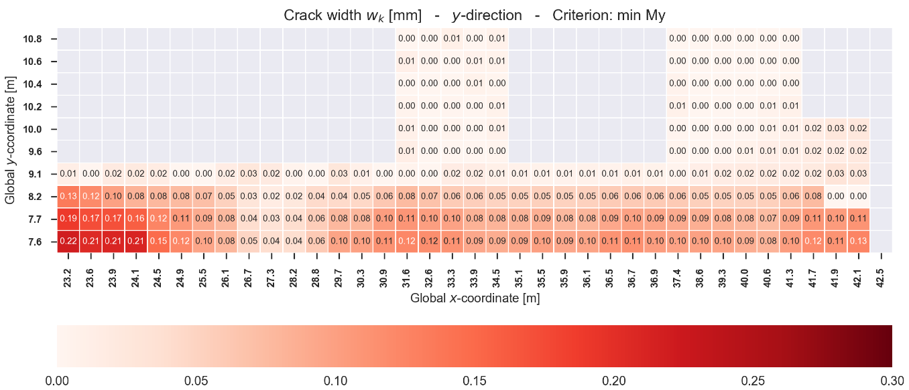
Examples - Plotting
Heatmap of crack widths in base slab

Slide 9
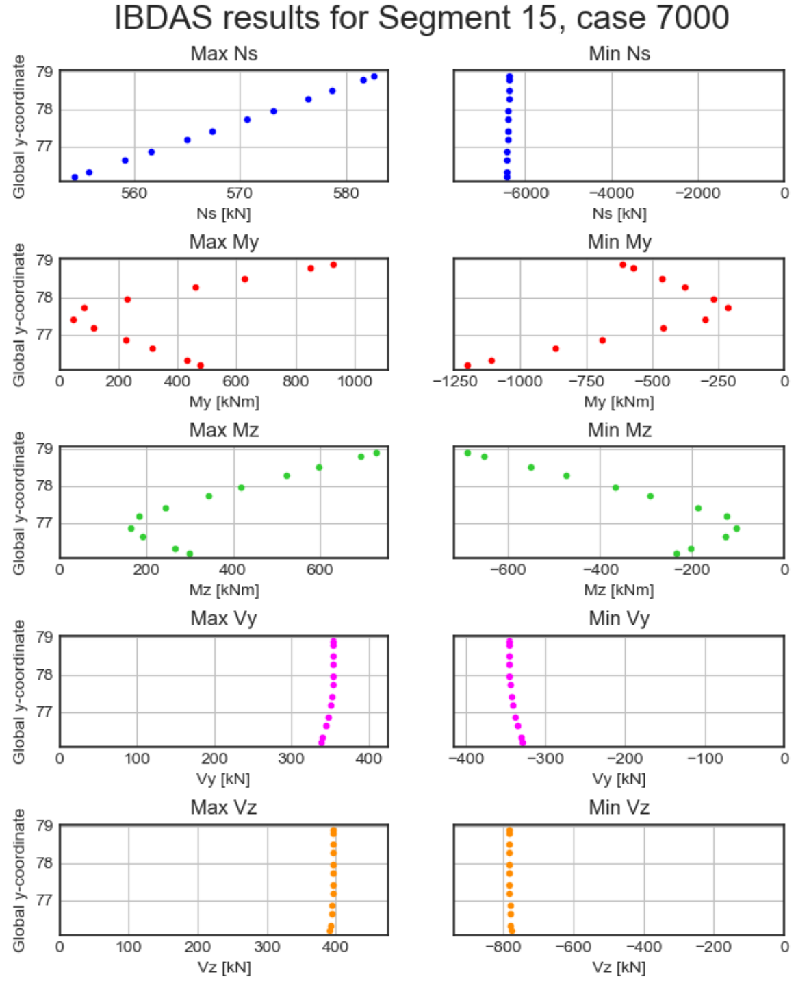
Examples – Plotting
IBDAS results for a column
Beam element
Large result file (show how it looks)
Results filtered and plotted
Results are envelopes This is the reason why points are not connected

Slide 10
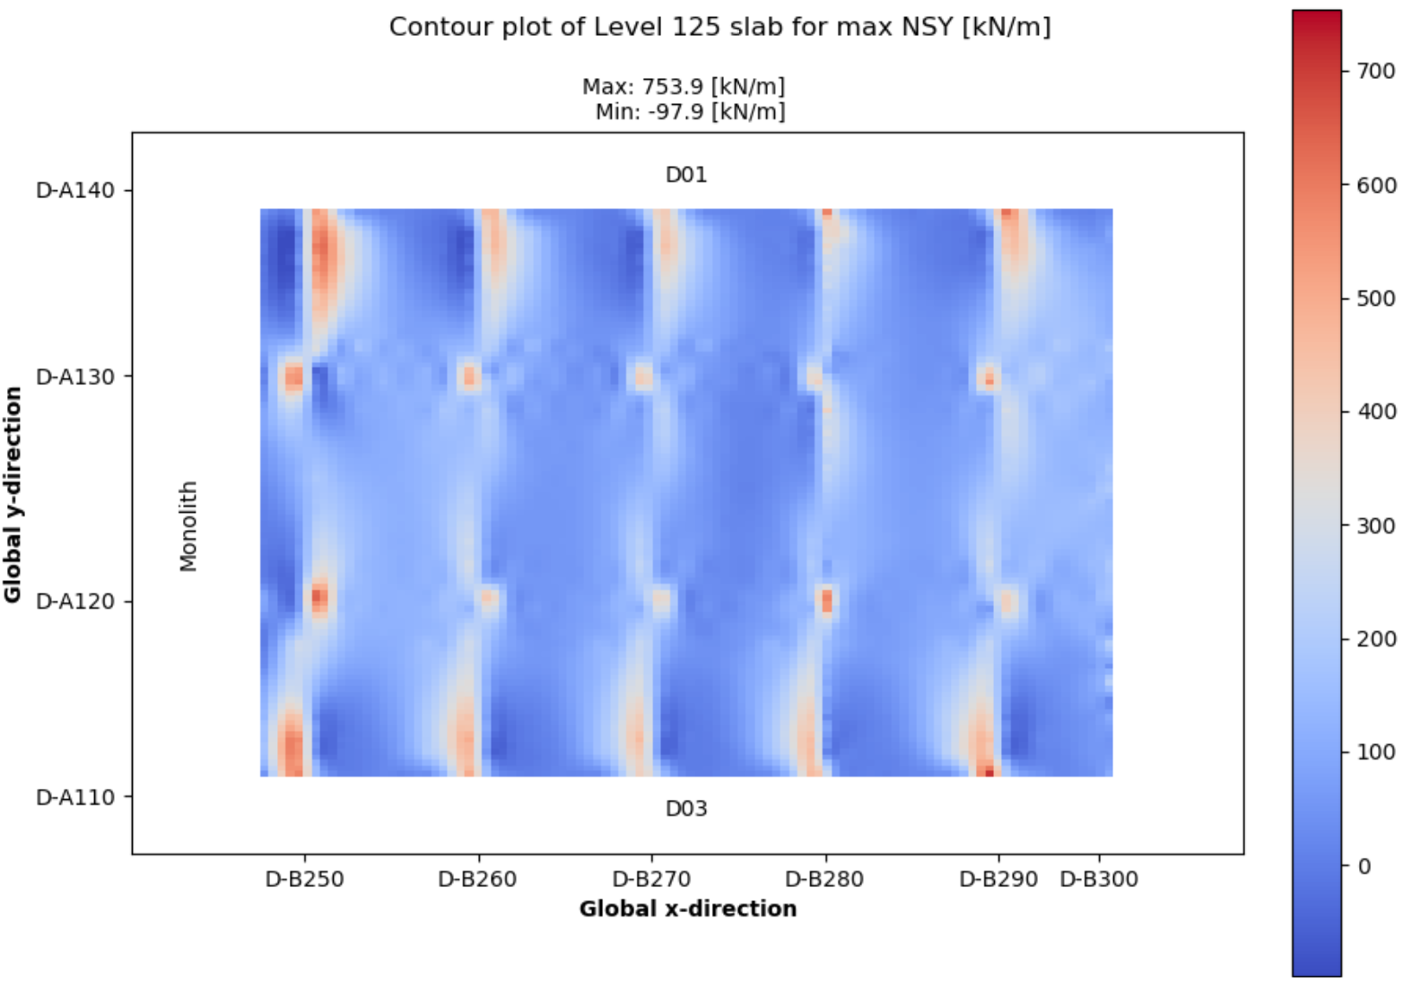
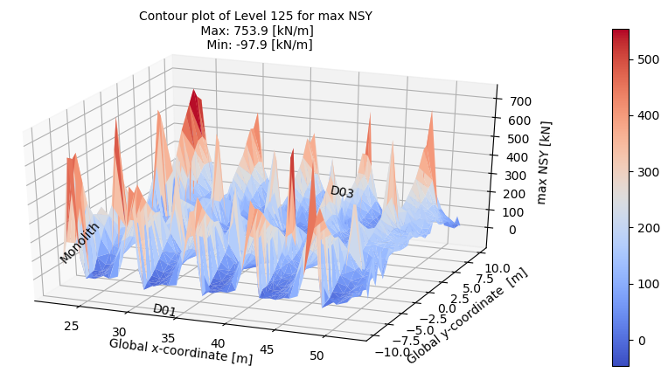
Examples - Plotting
1st floor slab results from IBDAS
Same results in two different plots
Custom text annotation
3D plot can be rotated
2D plot with custom gridlines

Slide 11
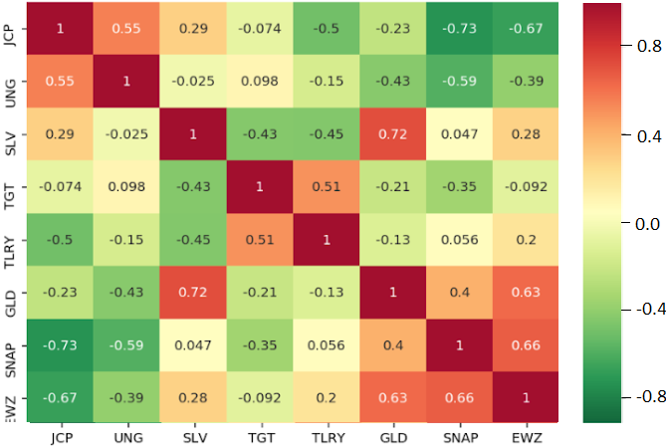
Examples - Plotting
Correlation matrix
Many time series boiled down to a graph
Correlation coefficient shown in each tile
Given a table/dataframe this plot can be produced in two lines of code
Scatter matrix example (plot everything vs eachother)

Slide 12
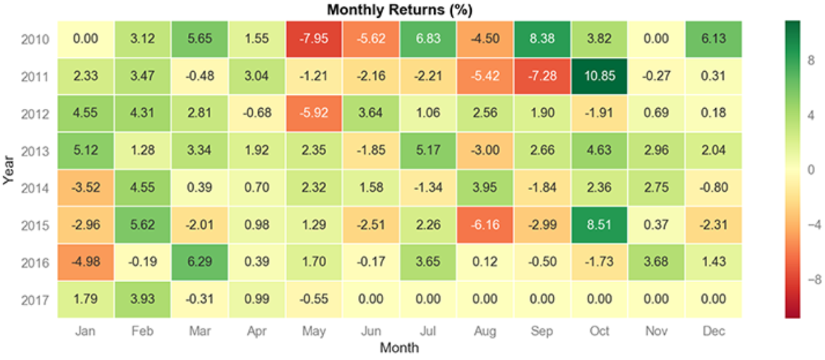
Examples - Plotting
Another heatmap example

Slide 13
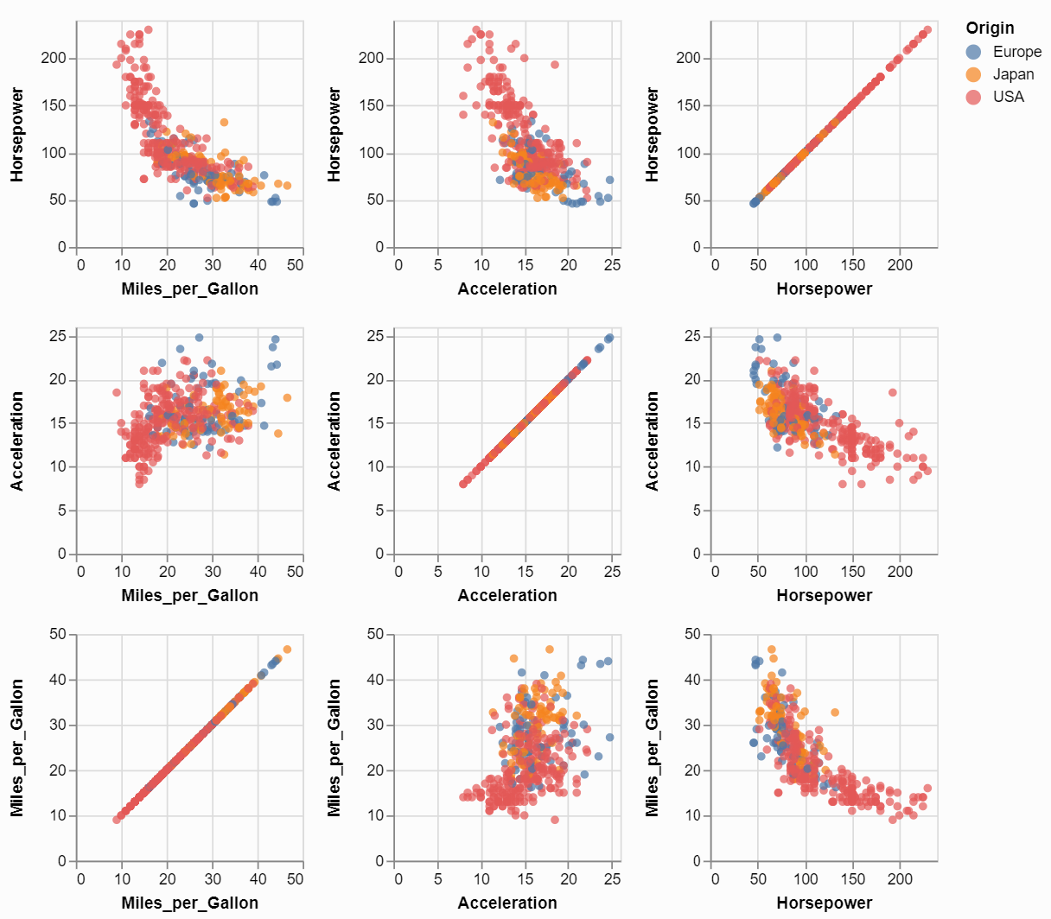
Examples - Plotting
Scatter matrix
Tiles are individual graphs
Everything plotted vs everything

Slide 14
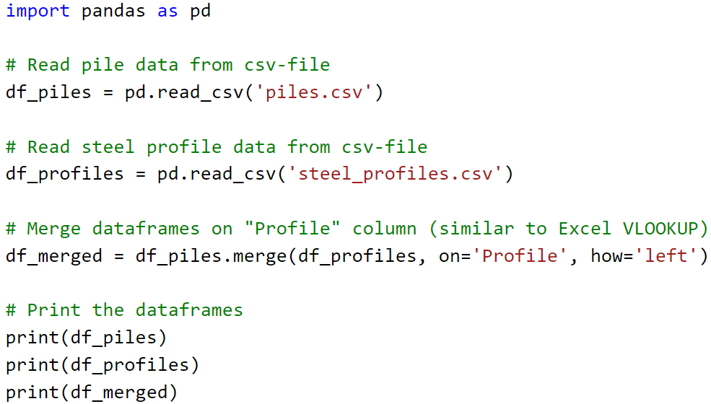
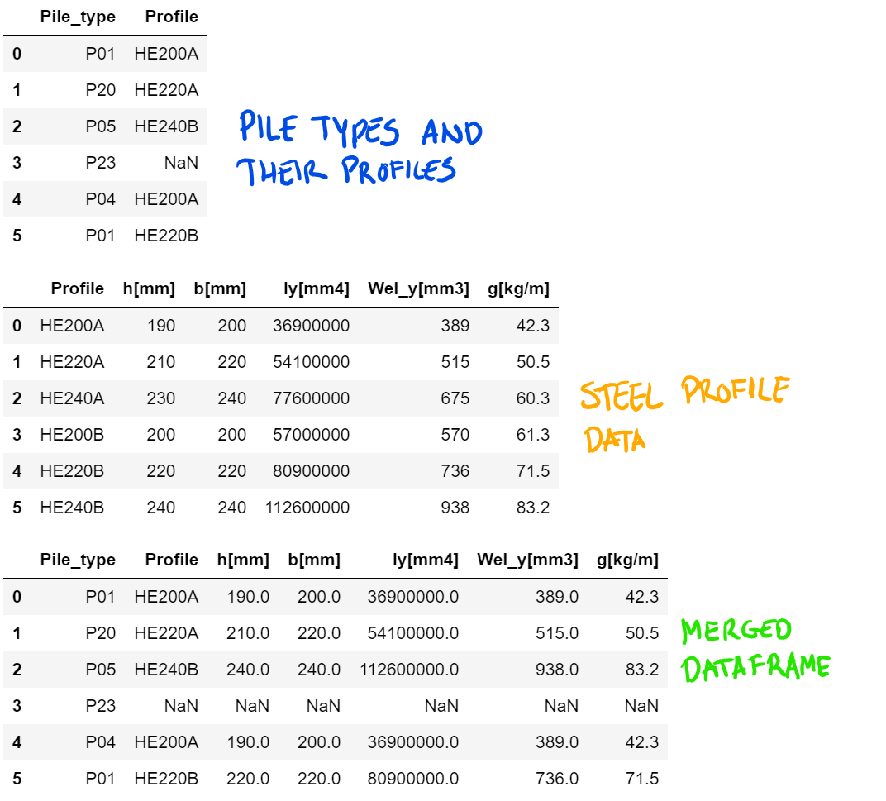
Panas dataframes - ‘VLOOKUP’ example
Code
Output
Scales with table sizes (both rows and columns)
Easily copied from one project to the next
Merged dataframe could be output as csv or xlsx-file to continue work in Excel

Slide 15
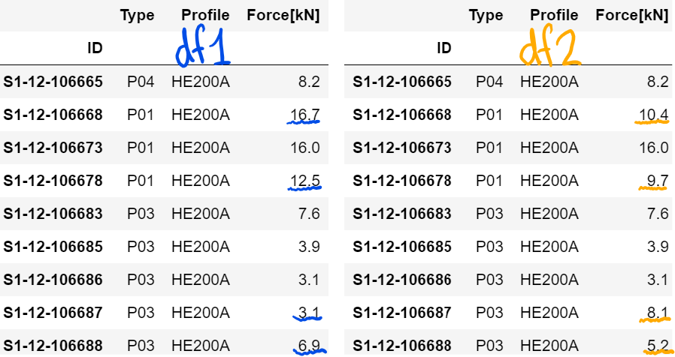
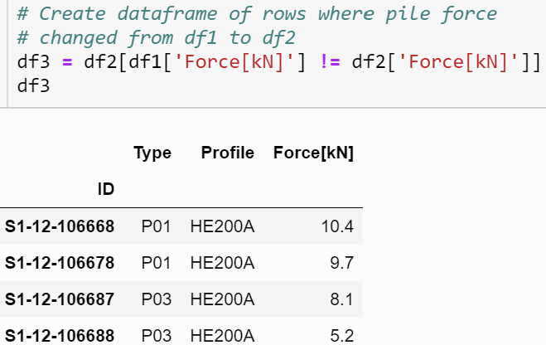
Dataframes - What changed bewteen versions?
Comparing versions of pile force data
New dataframe of only changed pile forces
One line of code
Useful for large datasets
Could be extended to show a lot more comparison details

Slide 16
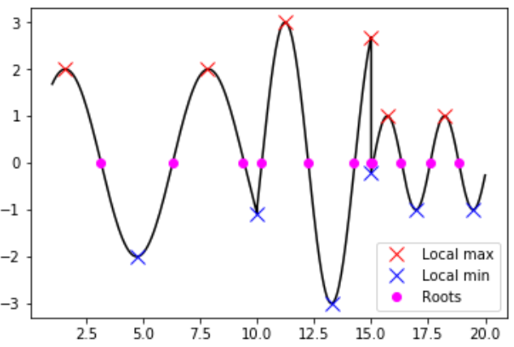
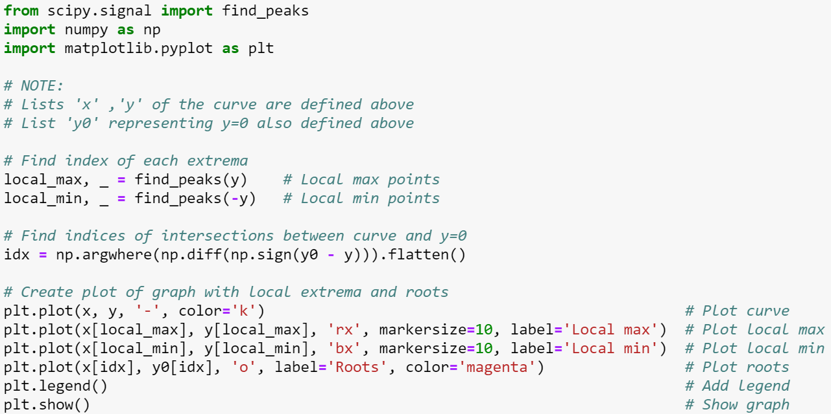
Scipy – example with peaks and roots
All points of interest found in three lines of code
Other lines are comments, imports and plotting

Slide 17
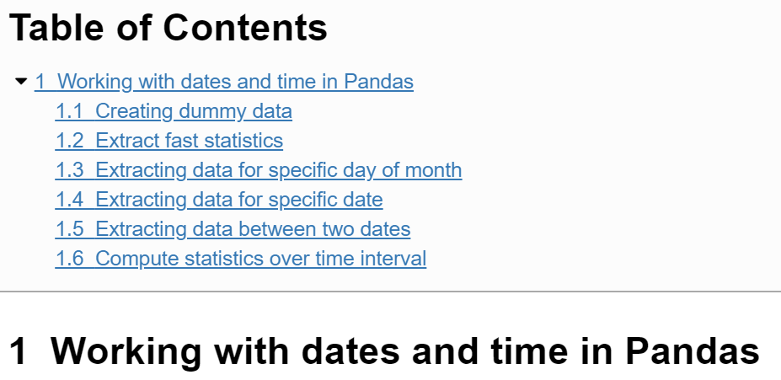
Dates and time in tables
Manipulate time series
Easy commands
Fast computations
Show demonstration in browser
(Jupyter Notebook)

Slide 18
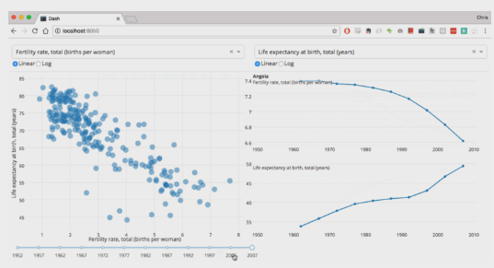
Dash web apps
Web apps in pure python
Possibly the easiest ways of making GUI’s
Very responsive and flexible
Show in browser
https://medium.com/@plotlygraphs/introducing-dash-5ecf7191b503
Issue
Online deployment and hosting

Slide 19
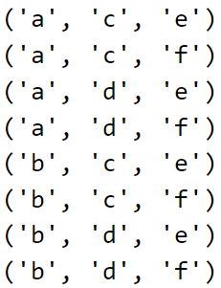
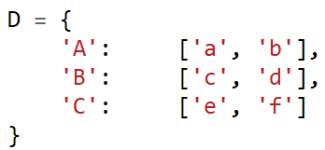


Other packages – Random and Itertools
Random
Simulate a roulette game
Itertools
Combinatorics (among other things)
Example: Create all possible load combinations:

Slide 20
Other packages - xlwings
Use Python with Excel
Much (if not all) functionality of VBA in Python environment
Access all subjects mentioned in prior slides
Put results calculated with Python into Excel sheets afterwards
Issue: sharing with people who does not have Python installed. Is it possible?
Note: There are other libraries that can talk to Excel Might be worth exploring!

Slide 21
Other things
Web scraping
Serch websites for information to use in projects
E.g.: find a table in COWI portal and get its contents
Scheduling of scripts
Make scripts run at a certain times or at specific intervals
Regular expressions
Search for any pattern in text
E.g.: Find all valid phone numbers in a text file
os library
Manipulate files, folders and other things in the operating system

Slide 22
Other things
Version control
Track all changes to code in a project via Git/GitHub
Create branches and merge when they are matured
Testing
Setup tests to make sure that the changes did not break anything

Slide 23
Wrap up
Questions and comments
Any other use cases we know of that were not mentioned?
Structure of workshop after basic sessions
Session 6 and forward
What do we want to accomplish and how?
Volunteers for organizing the workhop
Exercises
Session 2: Next tuesday

